Slide 1


Department of OUTCOMES
RESEARCH

Slide 2
Postoperative Respiratory Depression
Daniel I. Sessler, M.D.
Michael Cudahy Professor and Chair
Department of OUTCOMES RESEARCH
Cleveland Clinic
DS@OR.org
www.OR.org DS@OR.org

Slide 3
Voltaire, 1760
Physicians “poured drugs of which they knew little, for diseases of which they knew less, into humans of which they knew nothing.”

Slide 4
Oliver Wendell Holmes, 1860
“If all our drugs could be sunk to the bottom of the sea, it would be all the better for humans — and all the worse for the fishes.”
Notes:
Factor of a 100 reduction in the next century, and another factor of 100 since the French Society of Anesthesia founded in 1934. (Or factor of 10 since FAER founded in 1986.)

Slide 5
Perioperative Mortality
Intraoperative mortality rare
10-fold reduction in 3 decades
Thirty-day postoperative mortality
2% for inpatients ≥45 years old
Same as 1-year mortality in a 65-year-old
8-fold greater than a similar non-operative month
70% during initial hospitalization
>100-fold more than intraop mortality
Notes:
“Myocardial Injury after Non-cardiac Surgery” = MINS

Slide 6
Causes of Perioperative Mortality
Myocardial infarction is leading cause
Respiratory events contribute
≈45,000 US pts/yr need emergency ventilation
40% die before discharge
More common cause of morbidity
Most are probably preventable
40% of in-hospital cardiac arrests on wards
78% lethal
Notes:
“Myocardial Injury after Non-cardiac Surgery” = MINS
Anderson et al, Resuscitation 2016
Perman, J Am Heart Assoc 2016
Khan et al, J Gen Intern Med. 20016

Slide 7
Pathophysiology of PPCs
Obstruction
Respiratory muscle weakness, including residual blocks
Reduced ventilation, often from pain
Impaired respiratory control
And…

Slide 8
Opioid-induced Respiratory Depression
Closed-claims analysis
77% of episodes = death or severe brain injury
88% within 24 hours of anesthesia
97% deemed preventable
42% within 2 hours of last nursing check
Potential causes
Multiple prescribers
Potentiating non-opioid sedatives
Inadequate nursing assessment/response
Lee et al, Anesthesiology 2015
Notes:
357 acute pain malpractice claims that occurred between 1990 and 2009 – 92 judged as respiratory depression

Slide 9
PRODIGY-Identified Risk Factors
Cohort study
To validate risk prediction for respiratory depression
1335 patients receiving parenteral opioids
46% of patients experienced 1+ respiratory depression events
Predictive factors included: age ≥60, sex, opioid naivety, sleep disorders, and chronic heart failure
However, low sensitivity and specificity of predictive tool indicates poor individual risk prediction
Khanna et al, A&A 2020
Notes:
Khanna et al 2020
respiratory depression episode was defined as respiratory rate ≤5 breaths/min (bpm), oxygen
saturation ≤85%, or end-tidal carbon dioxide ≤15 or ≥60 mm Hg for ≥3 minutes; apnea episode
lasting >30 seconds; or any respiratory opioid-related adverse event.
Intermediate risk – sensitivity .86, specificity, .39
High risk – sensitivity .52, specificity .77
Often coughing fit/bronchospasm, not necessarily clinically relevant
Conclusion – cannot reliably predict risk in individuals. Not a great predictive tool, but could be useful at a population

Slide 10
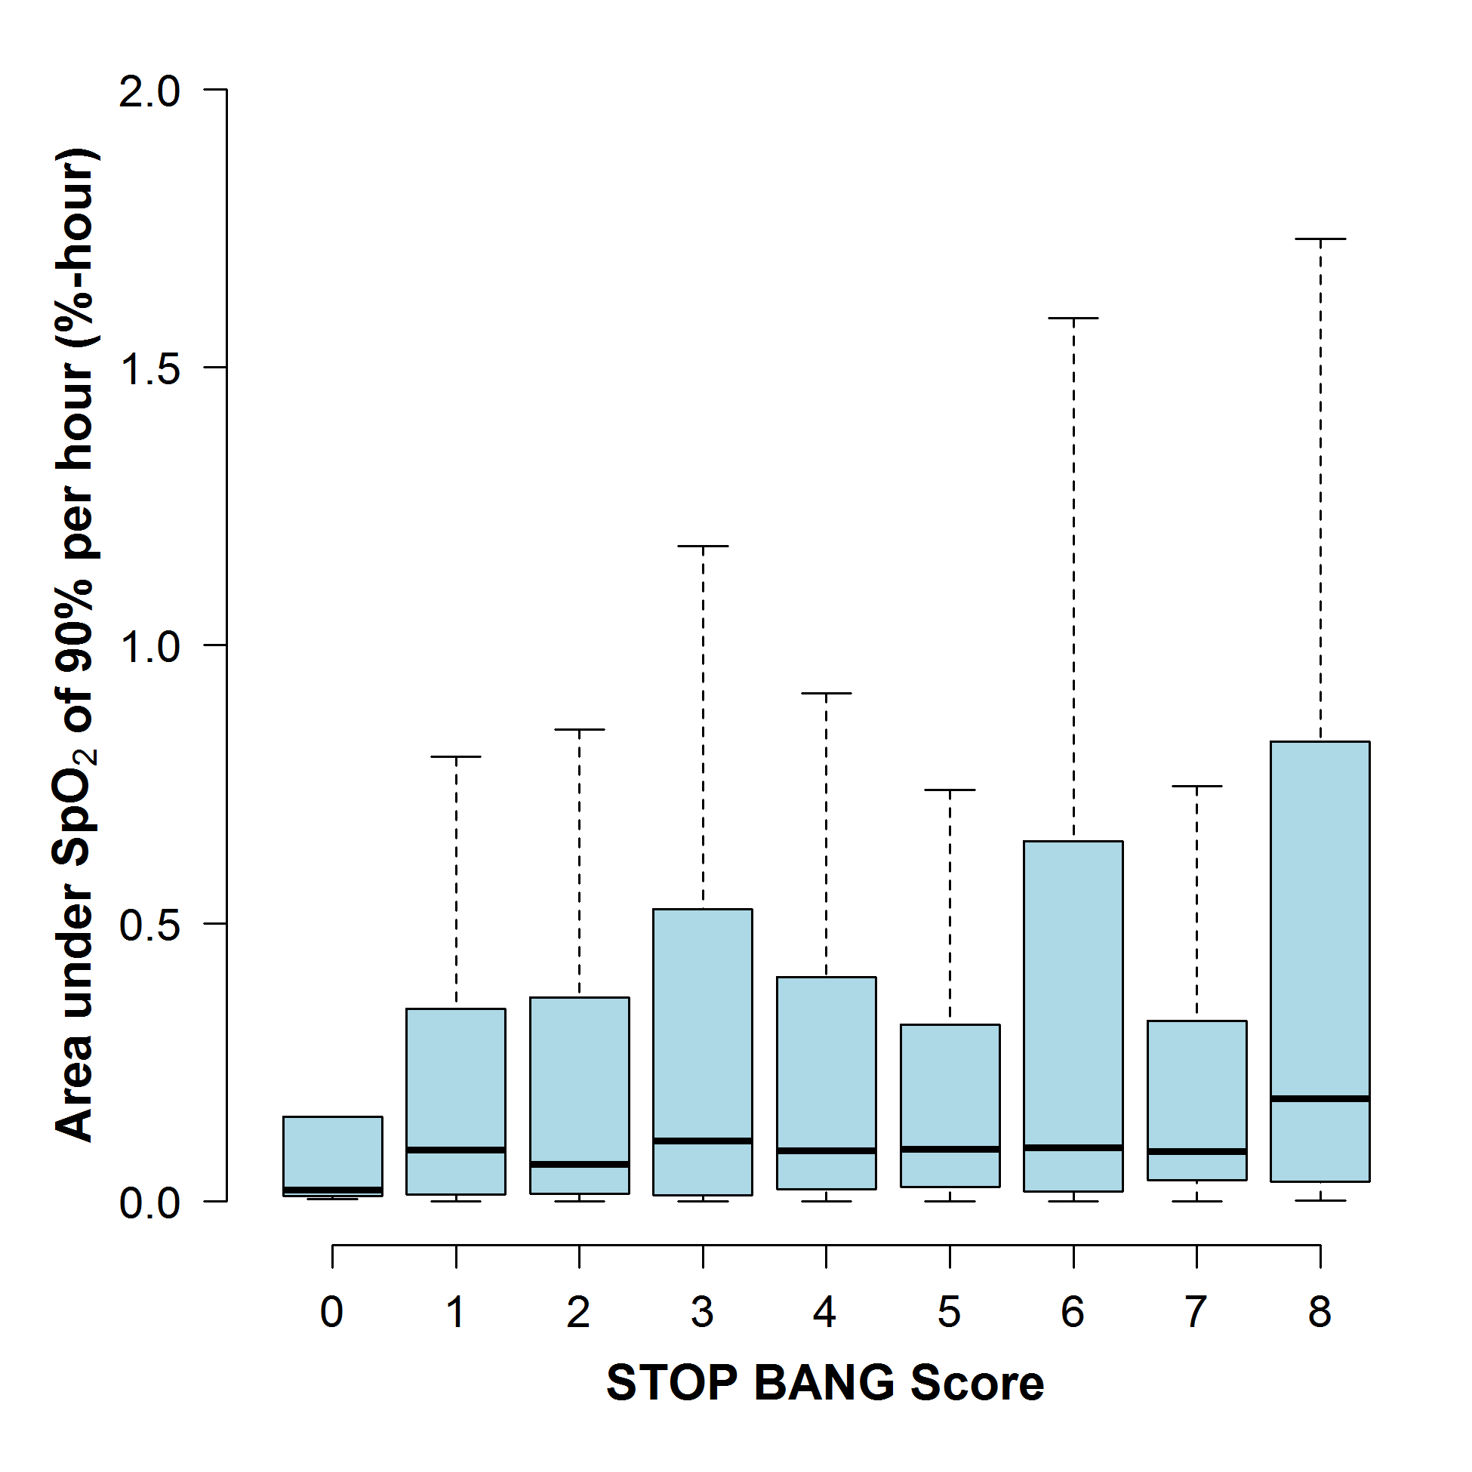
STOP-BANG Scores & Hypoxemia
Khanna et al, BJA 2016
Notes:
Explain stop-bang score – sleep apnea propensity score
Boxplot of Area under SpO2 of 90% per h for each STOP-BANG score category. No significant association was found between the STOP-BANG score and the median area under SpO2 of 90% per h, with a multivariable slope coefficient of 0.002 (95% CI: −0.01, 0.01; P=0.76) %-h for a unit increase in the score.
we proposed our hypothesis that higher STOP-BANG scores (more predictive of OSA), would also predict worse desaturation in OSA patients postoperatively

Slide 11
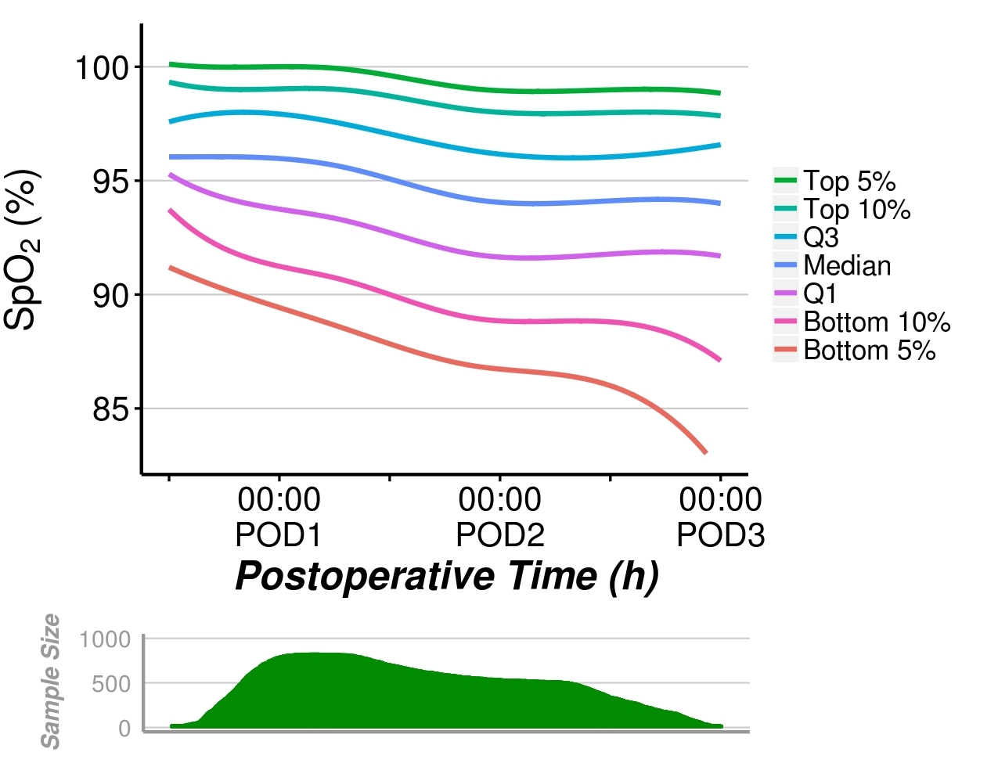
Blinded Saturation Over Time
Sun, A&A 2015
Notes:
patients >45 years old for up to 48 hours after noncardiac surgery in 1250 patients from Cleveland Clinic Main Campus and 250 patients from the Juravinski Hospital.
Just instantaneous measurements – distribution of saturations at function of time after surgery
Healthy patients attrition bias –
Individuals getting better over time

Slide 12
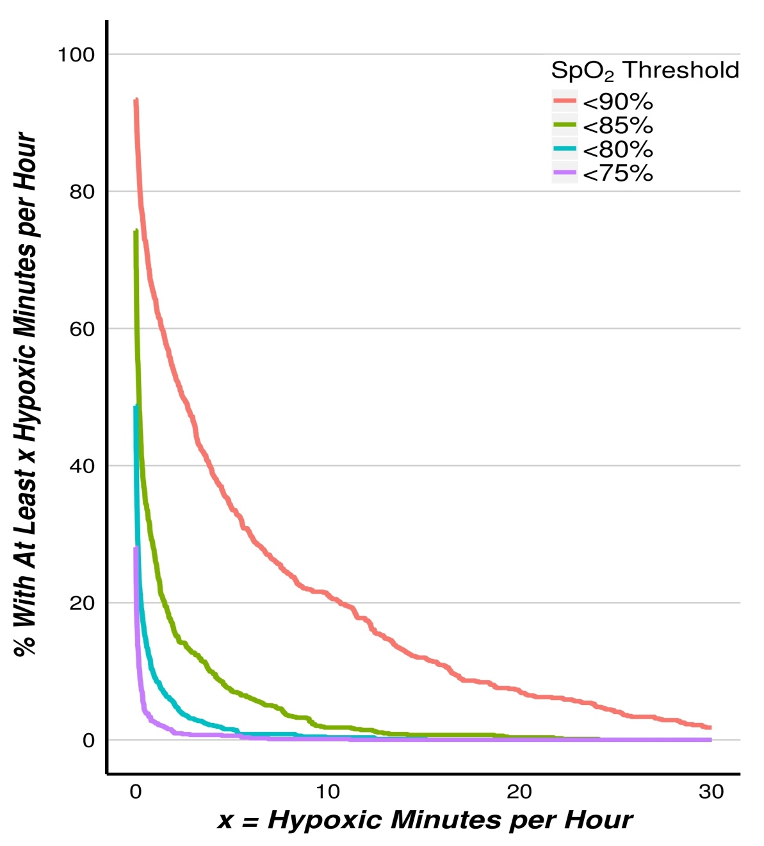
Minutes/hour of Hypoxemia
Notes:
12
Average minutes/hour of hypoxemia for 48 hour period –
Twenty-one percent (95% confidence interval, 18%–24%] of
patients averaged at least 10 minutes per hour with raw Spo2
values <90%, and 8% (6%–10%) of patients averaged at least
20 minutes per hour. Likewise, approximately 8% (6%–10%)
of patients averaged at least 5 minutes per hour with raw Spo2
<85%

Slide 13
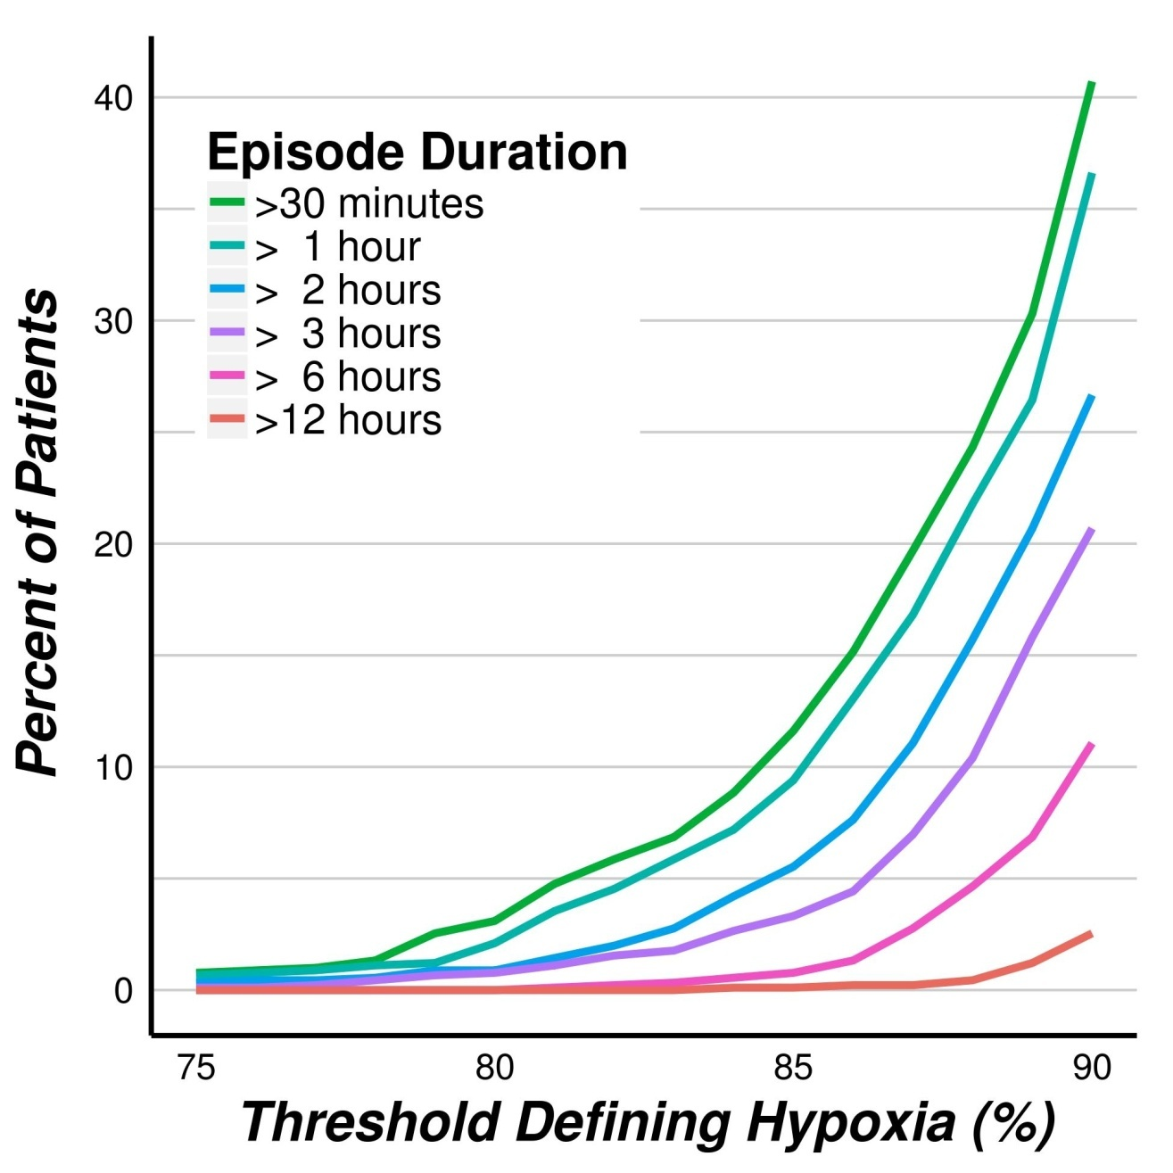
Hypoxemic Episode Duration
Nurses missed 90% of patients who had 1 continuous hour of saturation <90%
Notes:
13
anything that we can do to limit the amount of hypoxemia
prolonged hypoxemic episodes were common, according
to a threshold of Spo2 <90%, 37% (34%–40%) of patients
had at least 1 episode lasting an hour or more, while 11%
(9%–13%) experienced at least 1 episode lasting 6 hours or
more. Severely hypoxemic episodes, those <80% for at least
30 minutes, were observed in 3% (2%–4%) of patients (Fig. 5).

Slide 14
Hypoxemic Episodes Are Not Detected
Observational study of 782 patients
Nursing assessment every 4 hours
Continuous saturation monitoring
291 patients with 2,893 episodes of SpO₂ <90%
For at least 90% of 30 minutes
83% were not within ±10 minutes of nursing assessments
Negligible improvement during assessments
Nurses don’t arouse patients sufficiently to increase SpO₂
Saab et al, Anesthesiology 2021
Notes:
considered recorded times as approximate and used a 10-minute window before and after recorded time in our analyses
why nurses missed hypoxemia – happen b/w 4 hours or nurses wake patients
Happen in between nursing assessments
Additional support for continuous monitoring
Typically vital signs taken in 4-8 hour intervals – or even longer at some hospitals
Unchanged for half a century – nobody over 60, relatively small operations, week or long postoperative stay
Have not been updated
Interesting to characterize continuous monitoring

Slide 15
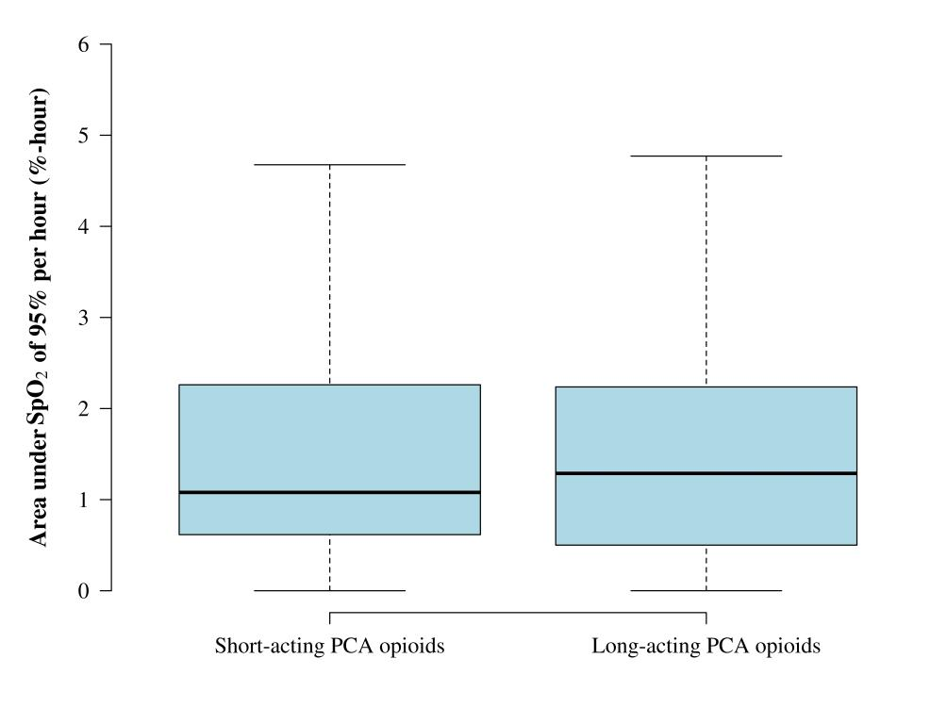
Short-acting PCA Opioids do not Help
Short-acting
Long-acting
Belcher, A&A 2016

Slide 16
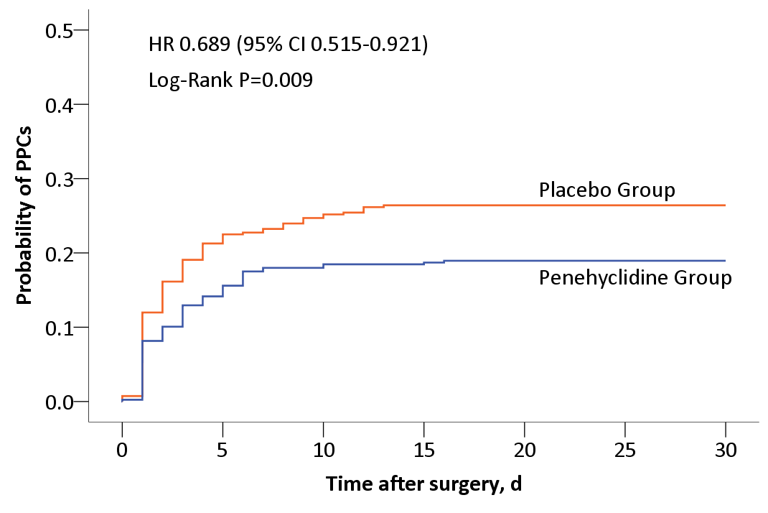
Penehyclidine Inhalation
RCT, N=826
Penehyclidine (anti-cholenergic) inhalation BID for 2 days
19% v. 26%, NNT = 13
Yan, Anesthesiology 2022

Slide 17
Ineffective Treatments, Trial Results
Saline v. balanced salt in surgical patients (N=8,616)
Crystalloid v. colloid (N=1,057)
Avoiding nitrous oxide (N=7,112)
30% v. 80% oxygen (N=5,056)
TV 6 v 10 ml and/or PEEP 5 v 8 cm H₂O (N=2,860)

Slide 18
Sugammadex v. Neostigmine
Observational results inconsistent
Some show benefit, others harm
All probably highly confounded by indication
Trial evidence shows no benefit
Togioka, BJA 2020
Alday, Can J Anesth 2019
Ledowski, BJA 2021

Slide 19
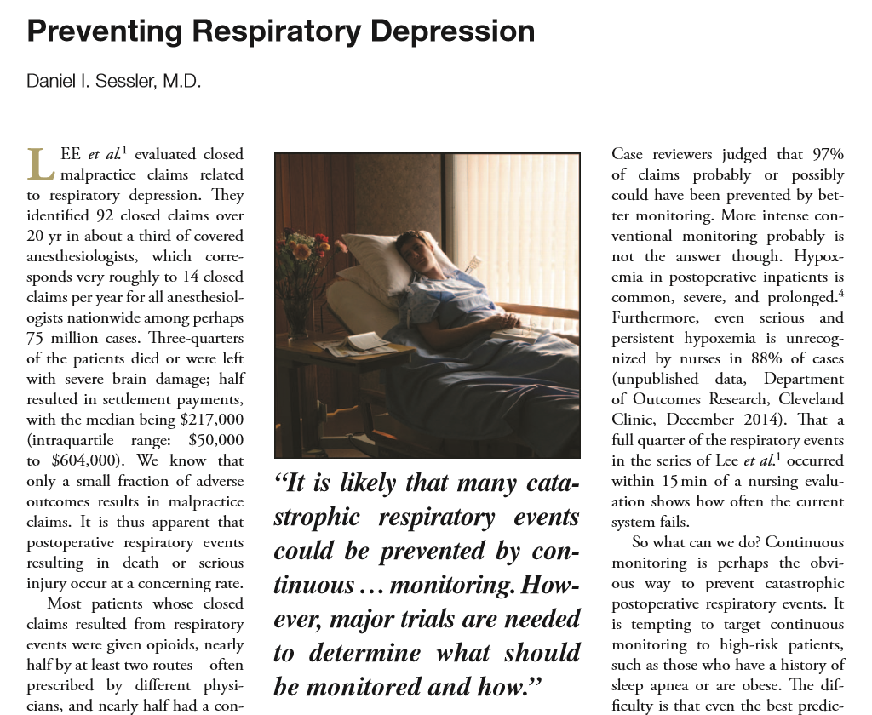


Continuous Ward Monitoring

Slide 20
Continuous Ward Monitoring Helps
Continuous ward monitoring
Pager notification to nurses
Saturation <80%, heart rate <50 or >140 beats/min
Before-and-after analysis (weak)
Reduced emergent rescue events
3.4 (2-5) → 1.2 (0.5-2) per 1000 patients
Reduced ICU transfers
5 (4-7) → 3 (1-4) per 1000 patients
Taenzer et al, Anesthesiology 2010
Notes:
Additional studies – before and after as well
Bellomo R, Ackerman M, Bailey M, Beale R, Clancy G, Danesh V, Hvarfner A,
Jimenez E, Konrad D, Lecardo M, et al. A controlled trial of electronic
automated advisory vital signs monitoring in general hospital wards. Crit
Care Med. 2012;40(8):2349–61.
Subbe CP, Duller B, Bellomo R. Effect of an automated notification system
for deteriorating ward patients on clinical outcomes. Crit Care. 2017;21(1):52.
Brown H, Terrence J, Vasquez P, Bates DW, Zimlichman E. Continuous
monitoring in an inpatient medical-surgical unit: a controlled clinical trial.
Am J Med. 2014;127(3):226–32.

Slide 21
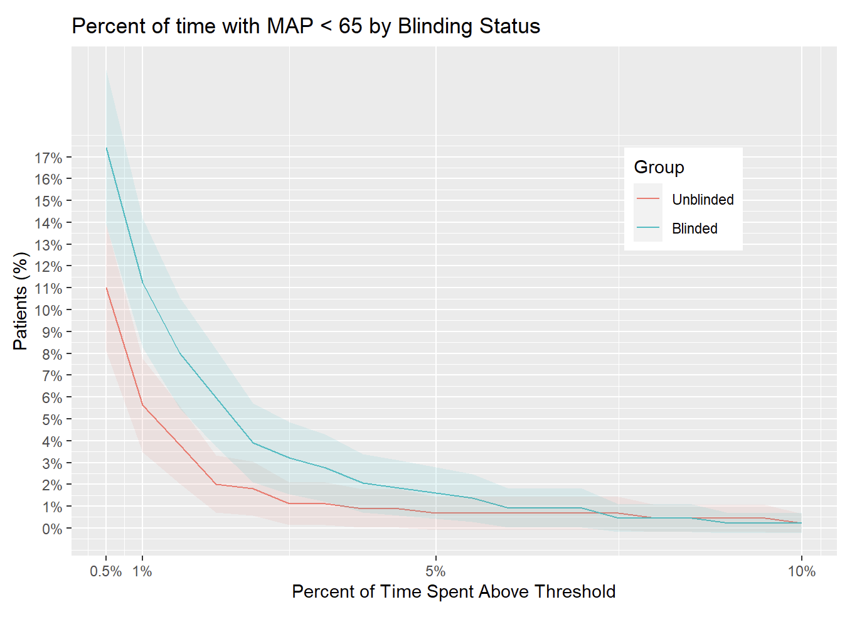
Randomized: Blinded v. Unblinded
909 patients
Continous monitoring
Khanna, et al
Wake Forest

Slide 22
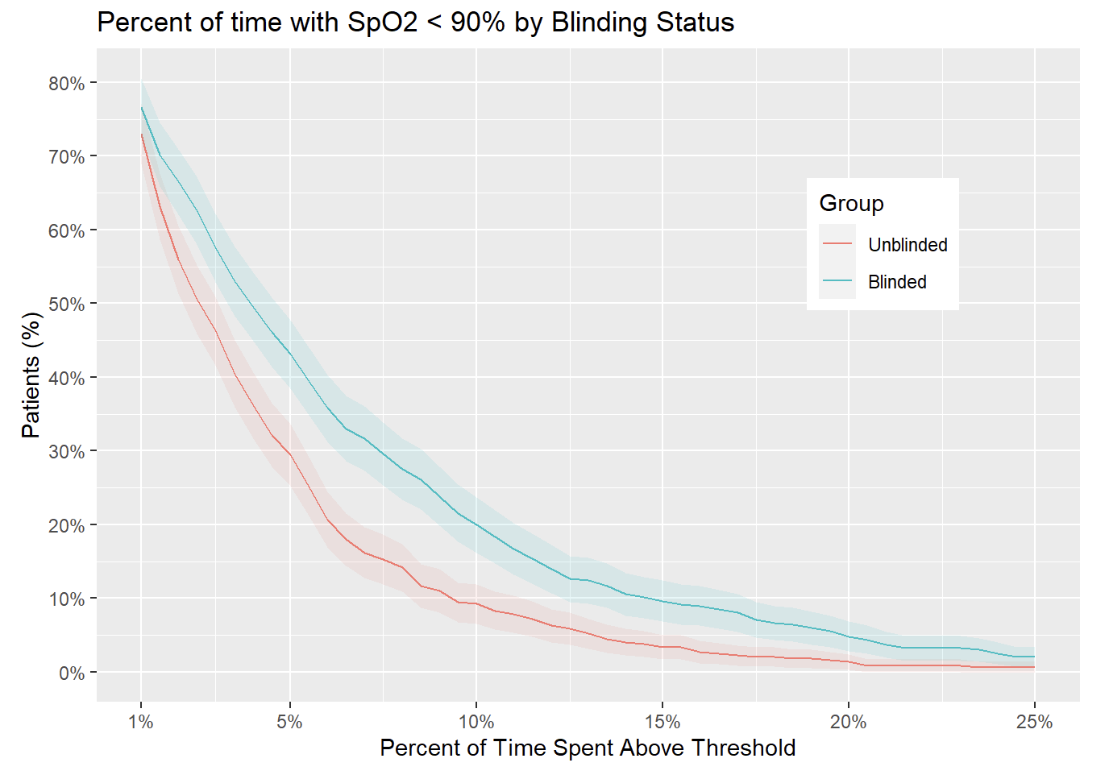
Randomized: Blinded v. Unblinded
909 patients
Continuous monitoring
Khanna, et al
Wake Forest

Slide 23
Randomized: Blinded v. Unblinded

Slide 25
Summary
Hypoxemia is common, profound, & prolonged
Cannot be reliably predicted or prevented
Continuous ward monitoring likely to help
Everyone, all the time!
Saturation ± ventilation, BP when possible
Smart systems to identify at-risk patients
Intervene before cardiorespiratory events
Much postoperative mortality is probably preventable

Slide 26
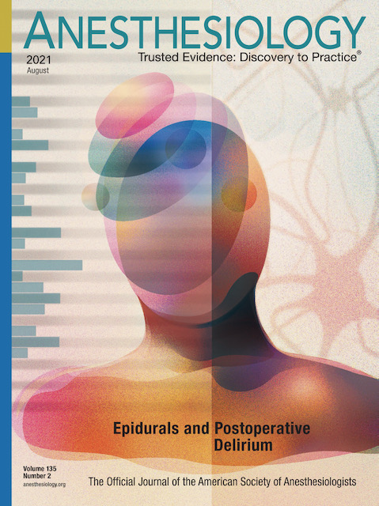
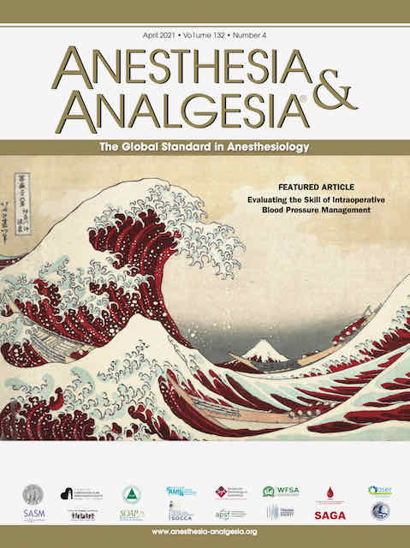

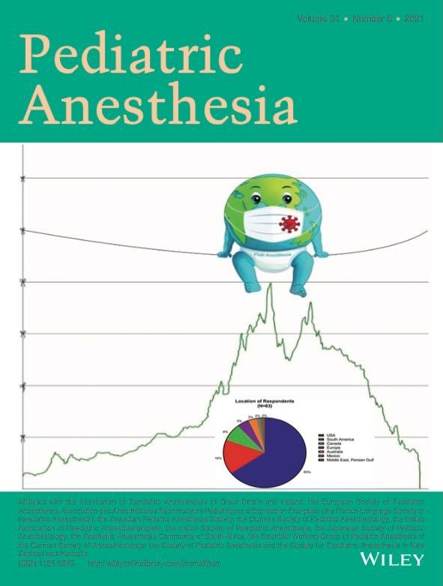
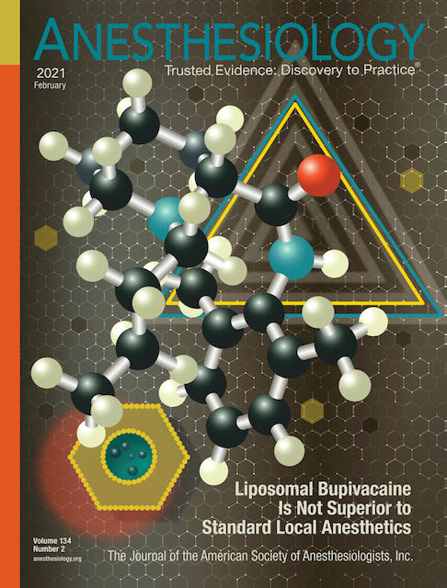
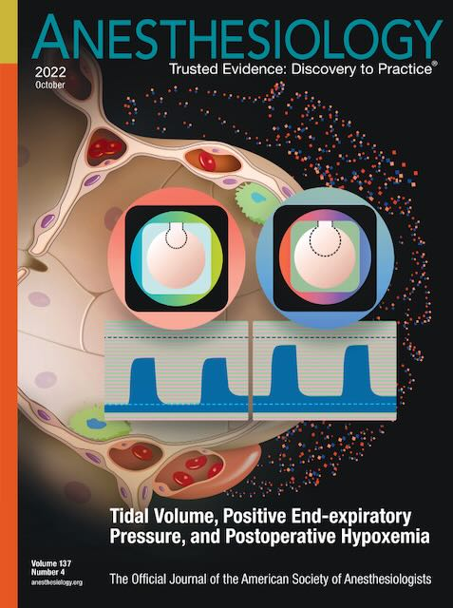
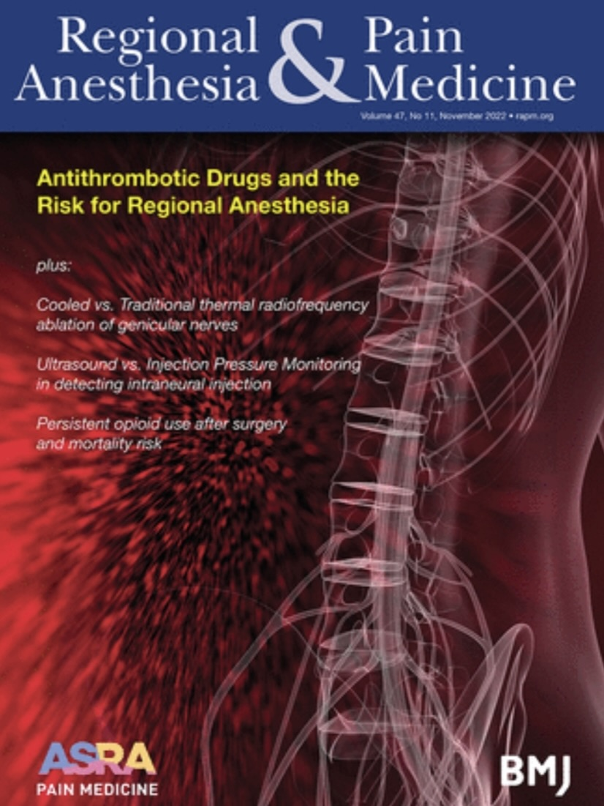
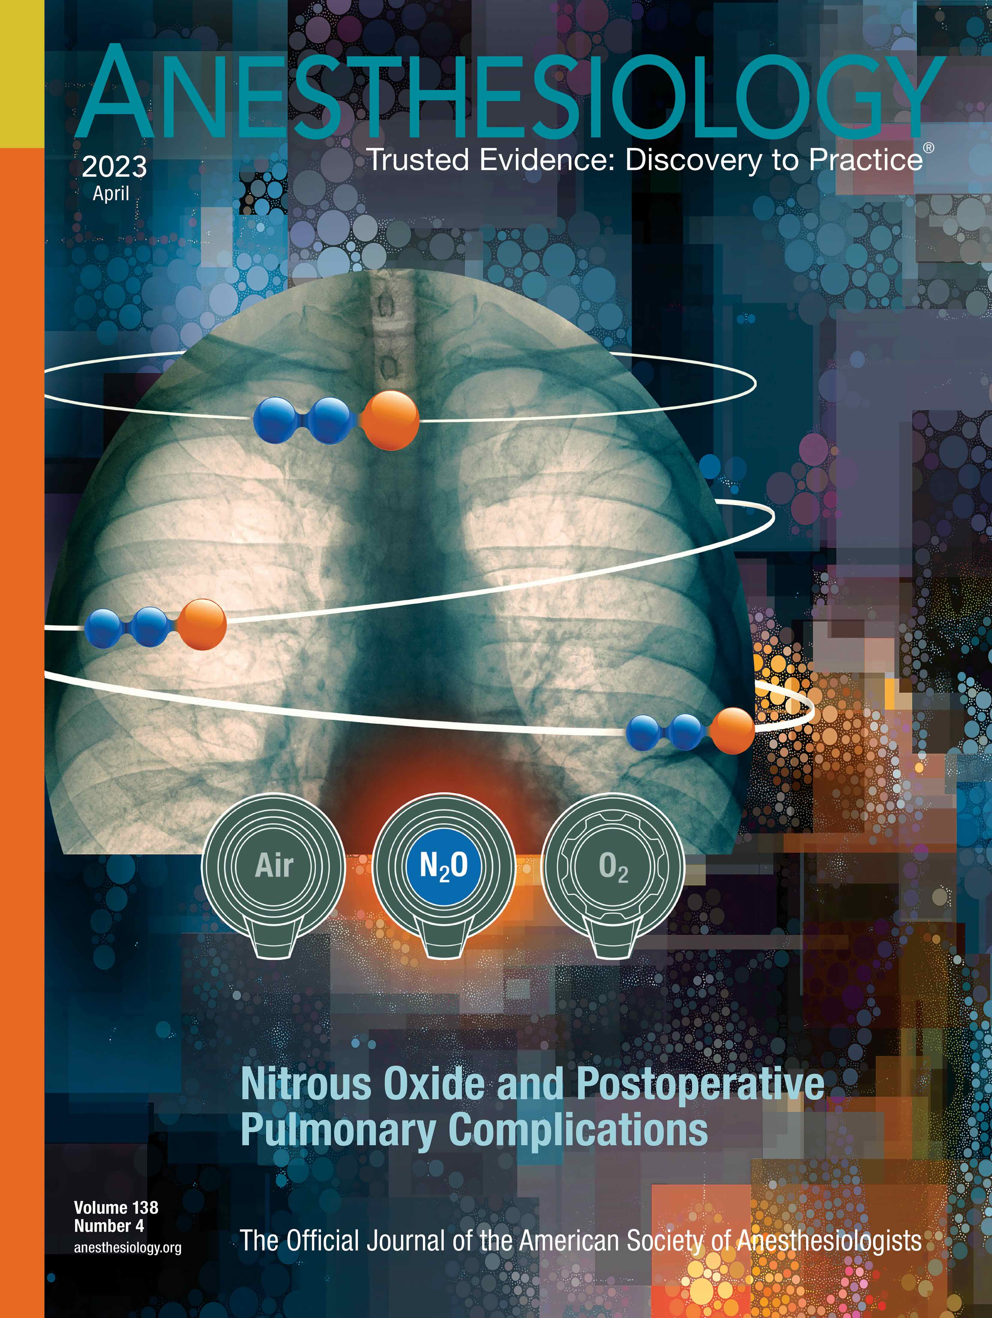
And that’s all folks…
Selected OUTCOMES RESEARCH covers since 2021

